Slide 1
Web Programming Language
Week 11
Managing State in REact

Slide 2
Managing State in React
Hooks
useState
useContext

Slide 3
Hooks
Hooks allow function components to have access to state amongst other React features.
Previously React used class components, but now function components (as we saw last week) are more popular.
Hooks
useState
useEffect
useContext
useRef
useReducer
useCallback
useMemo

Slide 4
useState Hook
Keeps track of the state of a function component
State refers to data or properties
Perhaps the number of times a tweet has been liked!
First step is to import useState into the component
import { useState } from 'react';

Slide 5
Initialising State
We can initialize the state using useState
useState accepts an initial state and returns 2 values;
The current state
A function to update the state
const Tweet = (props) => { const[likes, setLikes] = useState(0); …
Initial State
Current State
Function to update state

Slide 6
Using the state
Now the state can be used anywhere within the component
<p>Likes: {likes}</p>

Slide 7
Updating the State
We could add an event, perhaps a button click;
<button onClick={handleLike}>Like</button>
And then implement the handler which will call the update function
const handleLike = () => { setLikes(likes+1); }

Slide 8
Managing the State
Currently we have the ‘State’ stored in App.js
It is then accessed by other components using props
“Prop Drilling”
When state is passed down a tree of components, potentially passing through multiple nested components
Problems
The data may not be needed at each level
Is the App.js really the place to store the state?

Slide 9
TweetList.js
import React, {useState} from 'react’ import Tweet from './Tweet'; const TweetList = () => { const [tweets, setTweet] = useState([ { title: 'Hello’, content: 'React!’, likes: 2, id: 0 }, { title: '2nd Tweet’, content: 'What a world!’, likes: 6 , id: 1 }, { title: 'Feeling Good’, content: 'Loving life’, likes: 9 , id: 2 } ]); return ( <div> {tweets.map(tweet => ( <Tweet title={tweet.title} content={tweet.content} likes={tweet.likes} key={tweet.id} /> ))} </div> ) } export default TweetList
Array of Tweet Objects
Unique key needed for map

Slide 10
Tweet.js
Get initial likes from State
import './Tweet.css’; import { useState } from 'react’; const Tweet = (props) => { const[likes, setLikes] = useState(props.likes); const handleLike = () => { setLikes(likes+1); } return ( <div className="Tweet"> <h1>{props.title}</h1> <p>{props.content}</p> <p>Likes: {likes}</p> <button onClick={handleLike}>Like</button> </div> ); } export default Tweet;

Slide 11
Lets add a ‘Nav’ component
import React from 'react’ const Nav = () => { return ( <div> <h3>Profile: Ken</h3> <p>Number of Tweets: ?</p> </div> ) } export default Nav

Slide 12
Add it to the App.js
import './App.css’; import TweetList from './TweetList’; import Nav from './Nav’; function App() { return ( <div className="App"> <Nav /> <TweetList /> </div> ); } export default App;
But… how can it get access to the State? i.e. number of Tweets

Slide 13
useContext Hook
A way to manage state globally
Share state between deeply nested components more conveniently than using useState
Involves;
createContext
Context.Provider
useContext

Slide 14
TweetContext.js
Begin by importing useState & createContext
Export the TweetContext
import React, {useState, createContext} from 'react' export const TweetContext = createContext();

Slide 15
TweetContext.js
Add the State
export const TweetProvider = (props) => { const [tweets, setTweet] = useState([ { title: 'Hello’, content: 'React!’, likes: 2, id: 0 }, { title: '2nd Tweet’, content: 'What a world!’, likes: 6, id: 1 } ]); return ( <TweetContext.Provider value={[tweets, setTweet]}> {props.children} </TweetContext.Provider> ) }
Contains the state
Provides the array of Tweets
Passes state to child components

Slide 16
Remove State from TweetList
Adding useContext
import React, {useState, useContext} from 'react’ import Tweet from './Tweet’; import { TweetContext } from './TweetContext’; const TweetList = () => { const [tweets, setTweet] = useContext(TweetContext); return ( <div> {tweets.map(tweet => ( <Tweet title={tweet.title} content={tweet.content} likes={tweet.likes} key={tweet.id} /> ))} </div> ) } export default TweetList
Specify the Context we want to use

Slide 17
Wrap the App in the TweetProvider
(Braces because it isn’t default export)
import './App.css’; import {TweetProvider} from './components/TweetContext’; import TweetList from './components/TweetList’; function App() { return ( <TweetProvider> <div className="App"> <TweetList /> </div> </TweetProvider> ); } export default App;

Slide 18
Now the state can be available in the Nav
import React, {useContext} from 'react’ import { TweetContext } from './TweetContext’; const Nav = () => { const [tweets, setTweets] = useContext(TweetContext); return ( <div> <h3>Profile: Ken</h3> <p>Number of Tweets: {tweets.length}</p> </div> ) } export default Nav

Slide 19
useContext
useContext allows the state of the app to be available across any components

Slide 20
New Tweets?
We can create a Form component
Give it access to the state

Slide 21
AddTweet.js
import React, {useState, useContext} from 'react’ import { TweetContext } from './TweetContext’; const AddTweet = () => { const [title, setTitle] = useState(‘’); const [content, setContent] = useState(‘’); const [tweets, setTweet] = useContext(TweetContext); const updateTitle = (e) => { setTitle(e.target.value); } const updateContent = (e) => { setContent(e.target.value); } const addTweet = (e) => { e.preventDefault(); setTweet(prevTweets => [...prevTweets, {title: title, content:content, likes:0, id: tweets.length}]) } return ( <form onSubmit={addTweet}> <input type="text" name="title" value={title} onChange={updateTitle}/> <input type="text" name="content" value={content} onChange={updateContent}/> <button>Submit</button> </form> ) } export default AddTweet

Slide 22
Problem
What happens when we refresh the page?
The state returns to the default state
We aren’t storing the data anywhere!
Of course storing data on a server makes sense, but for now we can consider storing data in the browser, in localStorage

Slide 23
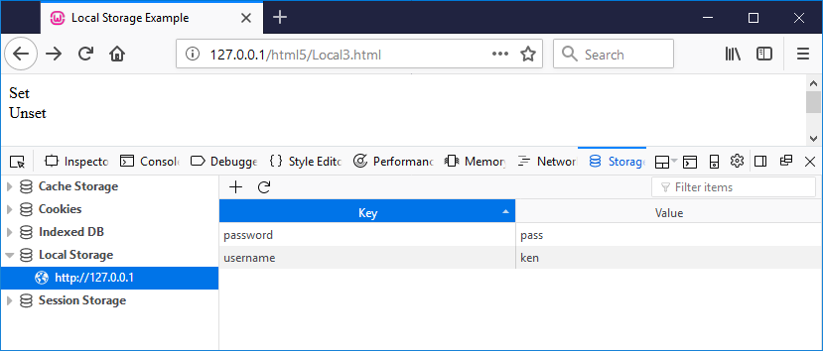
Local Storage
Cookies of the “future”!
<div id='set'>Set</div> <div id='unset'>Unset</div> <script> $(document).ready(function(){ $("#set").click(function() { localStorage.setItem('username', 'ken') localStorage.setItem('password', 'pass') }); $("#unset").click(function() { localStorage.removeItem('username') localStorage.removeItem('password') }); }); </script>);

Slide 24
Editing addTweet
We could set the tweets state to localStorage when a new tweet is added
const addTweet = (e) => { e.preventDefault(); setTweet(prevTweets => [...prevTweets, {title: title, content:content, likes:0, id:tweets.length}]); localStorage.setItem('tweets', JSON.stringify(tweets)); }
What happens?

Slide 25
State
Even though we “changed” the state using setTweet, the state of the tweet object remains as it was at start of the function!
“Gotcha”
Hack around
const addTweet = (e) => { e.preventDefault(); setTweet(prevTweets => [...prevTweets, {title: title, content:content, likes:0, id:tweets.length}]); const allTweets = tweets; allTweets.push({title: title, content:content, likes:0, id:tweets.length}); localStorage.setItem('tweets', JSON.stringify(allTweets)); }

Slide 26
Retrieving from LocalStorage
export const TweetProvider = (props) => { const [tweets, setTweet] = useState(JSON.parse(localStorage.getItem('tweets'))); return ( <TweetContext.Provider value={[tweets, setTweet]}> {props.children} </TweetContext.Provider> ) }

Slide 27
Recommended on YouTube
https://www.youtube.com/watch?v=35lXWvCuM8o

Slide 28
Key Points
Managing State in React
useState
useContext
localStorage

